Slide 1
NoSql Hosting in Azure Cloud
Team: 3
Rupa Mahendran
Sriganesh Baskaran
Yoshitha Gattu
Sai kiran Gontyala

Slide 2
Table of Contents
Objectives
Introduction
Literature survey
NoSql Deployments-Windows,Linux,Azure
Discussion
Conclusion
References

Slide 3
Objectives
To explore Nosql server
To test and deploy Nosql in windows OS
To test and deploy Nosql in Linux OS
To test and deploy Nosql in Azure cosmos environment

Slide 4
Introduction
Microsoft Azure - Cloud computing service created by Microsoft for building, testing, deploying, and managing applications and services through Microsoft-managed data centers.
A NoSQL database environment - Non-relational database system that allows for the fast organization and analysis of disparate and high-volume data types.
MongoDB - The most popular NoSQL.The growth of MongoDB has been impressive over the last few years as a document-oriented database system that uses JSON-like objects for describing the data model.

Slide 5
Literature Survey
MongoDB - Windows Installer (.msi) installation package.
The MSI package is contained within a ZIP archive.
The Microsoft Windows Installer Engine was updated with the release of Windows XP.
Microsoft has recently introduced the WiX (Windows Installer XML) toolkit - first highly acknowledged Open Source project from Microsoft.

Slide 6
Literature Survey
Azure Cosmos DB is Microsoft’s proprietary globally-distributed, multi-model database service "for managing data at planet-scale" launched in May 2017. It is schema-agnostic, horizontally scalable and generally classified as a NoSQL database

Slide 7
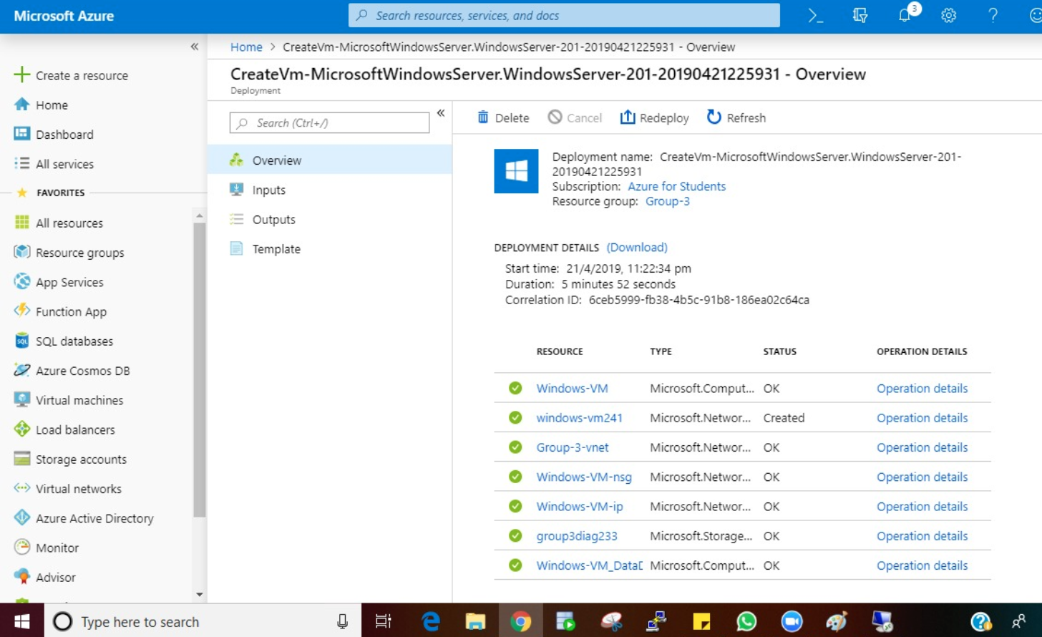
Main Body
Nosql in Windows

Slide 8
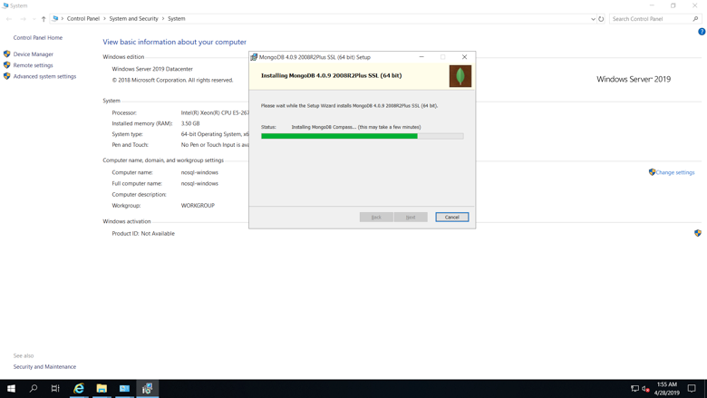

Slide 9
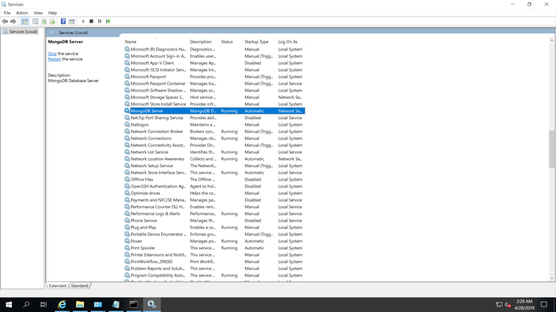

Slide 10
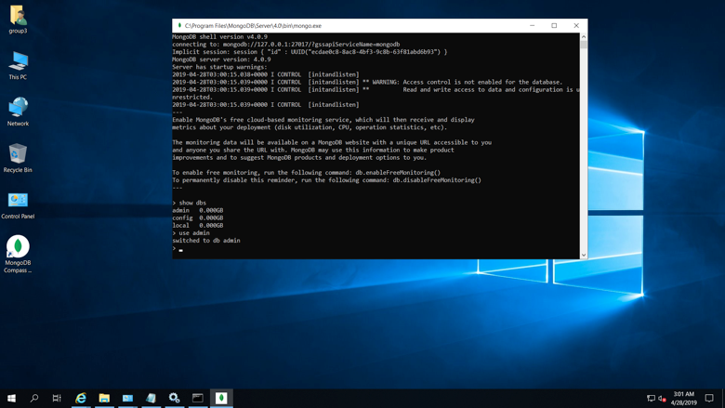
MongoDB Deployment-Windows

Slide 11
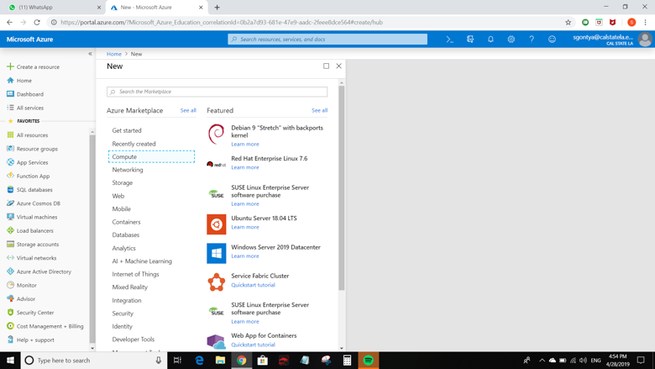
Nosql in Linux

Slide 12
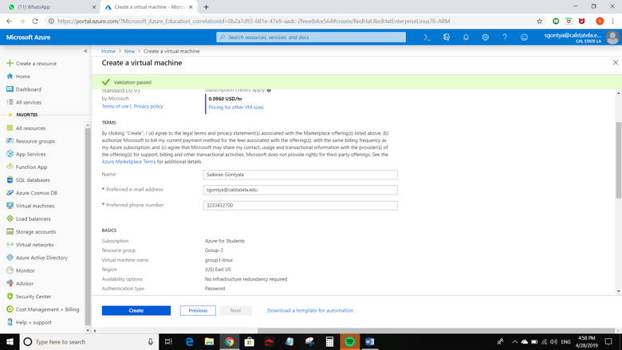

Slide 13
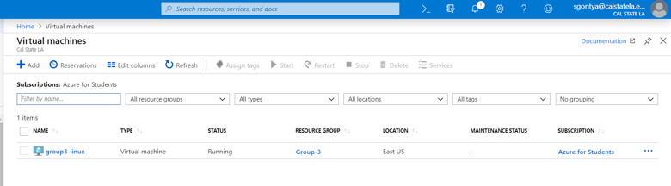
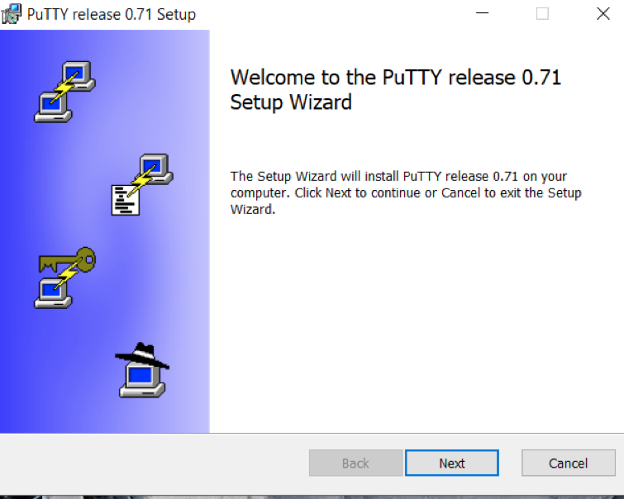

Slide 14
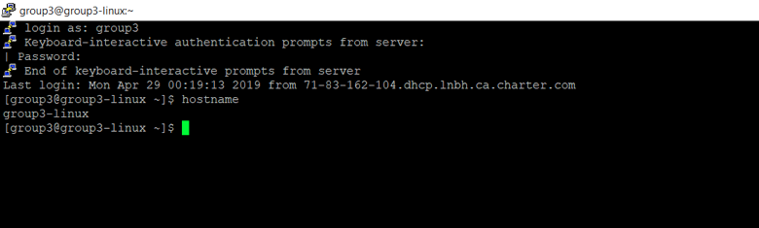
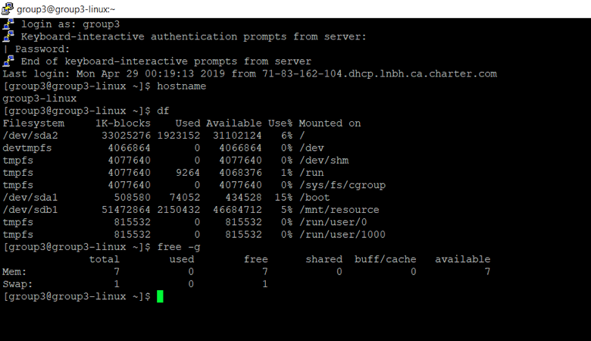

Slide 15
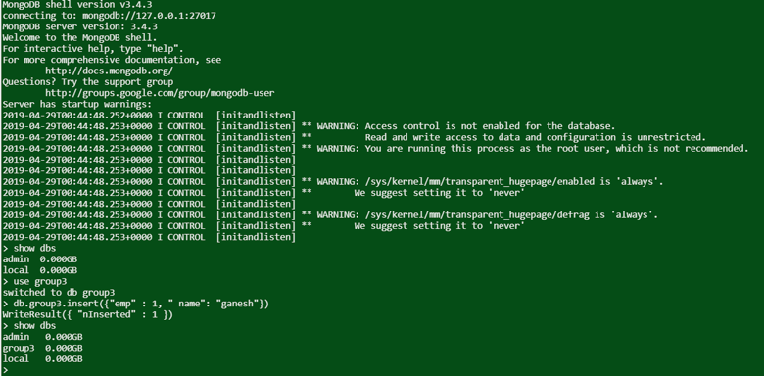

Slide 16
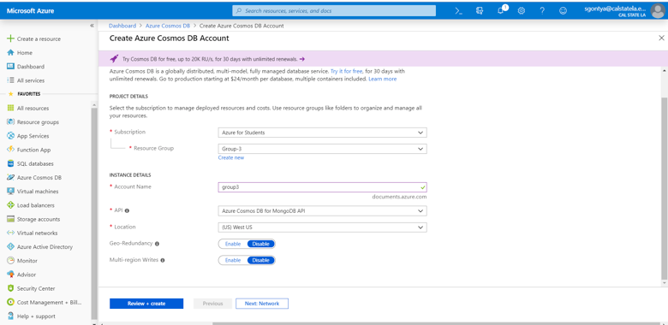
COSMOSDB in Azure

Slide 17
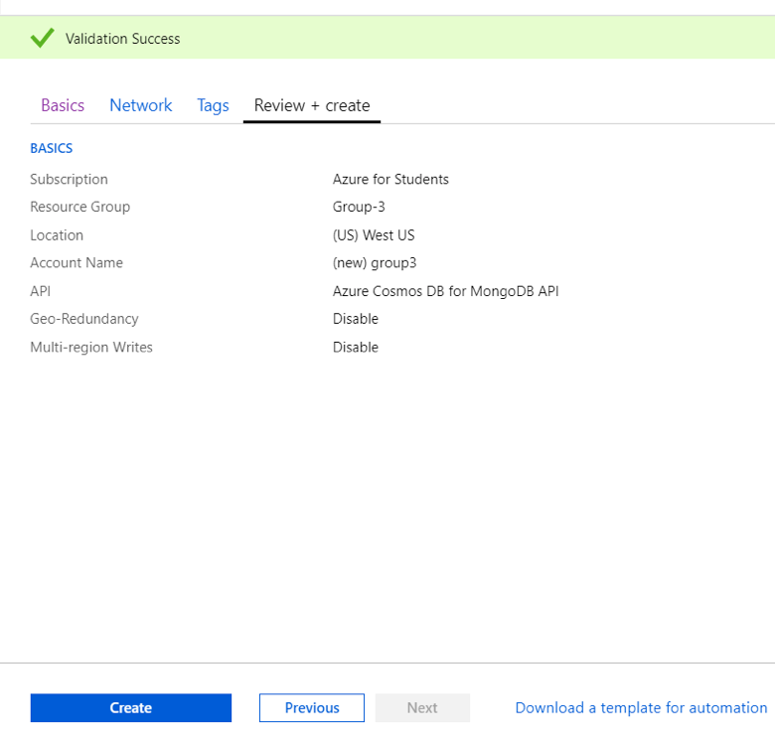

Slide 18
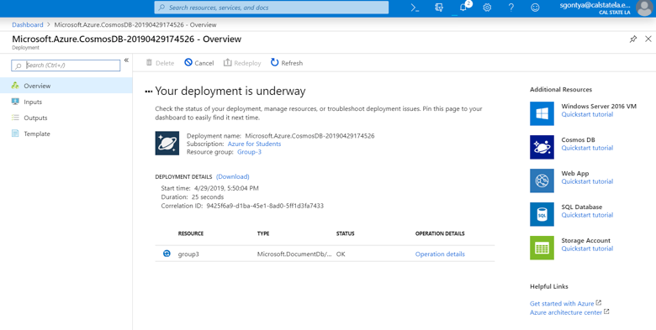

Slide 19
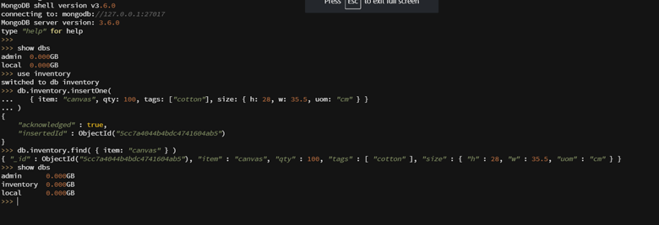

Slide 20
Discussion
Mongo replication has been tested in both windows and linux platform, and replication synchronisation occur seamlessly
It is found that the mongo services are working faster in linux platform than in windows.

Slide 21
Conclusion
Virtual machines of both windows and linux operating systems has been deployed successfully on microsoft Azure cloud services using defaultly available machine images.
Installation of mongodb and database services has been tested by creating database and adding the sample mongodb documents using mongo queries.

Slide 22
Web References
https://www.mongodb.com/
https://docs.microsoft.com/en-us/azure/
https://docs.microsoft.com/en-us/azure/virtual-machines/windows/install-mongodb

Slide 23
Question and Answer Session
The End

